Slide 1
Defensive Security Project
by: [Johnny Ward, Benjamin Chiu,
Zhi Ren Chow, Naiara Narino]

Slide 2
Table of Contents
This document contains the following resources:
Monitoring Environment
Attack Analysis
Project Summary & Future Mitigations

Slide 3

Monitoring Environment
‹#›

Slide 4
Scenario
In this project, our team played the role of a SOC analyst for an organisation called Virtual Space Industries (VSI). VSI specialises in the design of virtual-reality programs for businesses. There had been rumors that a competitor, JobeCorp, may launch cyberattacks to disrupt VSI’s business. Therefore as the SOC analysts, we were tasked with using Splunk to monitor against potential attacks to the systems and applications.
The following is a list of VSI products we will be monitoring:
-An administrative webpage: https://vsi-corporation.azurewebsites.net/
-An Apache web server hosting the webpage.
-A Windows operating system which runs many of VSI’s back-end operations.
Our networking team provided us with past logs to help us to develop baselines and create reports, alerts and dashboards to protect VSI from any attacks from JobeCorp.

Slide 5
Website Monitoring
‹#›

Slide 6
Website Monitoring
Monitor websites to detect downtime and performance problems. This app uses a modular input that can be setup easily (in 5 minutes or less).
Key Features:
Uptime Calculation: The Status History dashboard provides information about the past failures and calculates the website’s uptime percentage.
Status Monitoring Dashboard: Provides the response time for your monitored websites and provides a historical analysis of the site’s responsiveness.
Email Outage Alerting: Receive an emailed alert when your website is down, responds too slowly or is returning an error.
Change History Dashboard: Provides information regarding when the monitored pages, changed.

Slide 7
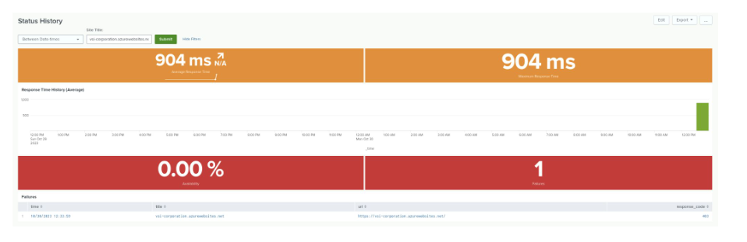
Status History

Slide 8
Logs Analyzed
Windows Logs
Apache Logs
1
2
This server contains intellectual property of VSI’s next-generation virtual-reality programs.
This server is used for VSI’s main public-facing website: vsi-company.com

Slide 9
Windows Logs
‹#›

Slide 10
Reports—Windows
Designed the following reports:
Report Name | Report Description
ID numbers associated with specific signature | A report showing the ID number associated with the specific signature for Windows activity
Windows Logs severity | A report that shows the severity levels of the Windows logs being viewed
Success & Failure on Windows activities | A report that shows if there are suspicious level of failed activities on the server

Slide 11
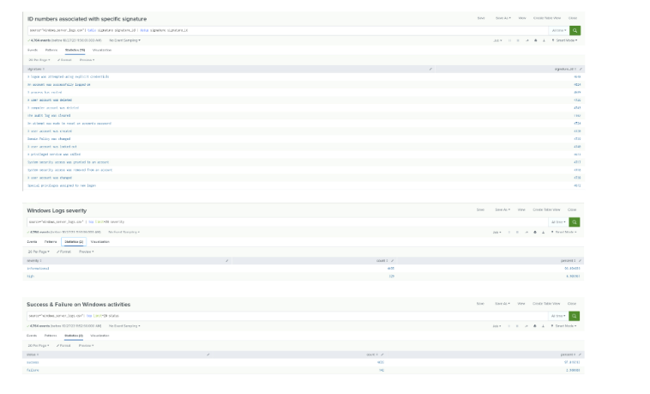
Images of Reports—Windows

Slide 12
Alerts—Windows
Designed the following alerts:
Alert Name | Alert Description | Alert Baseline | Alert Threshold
VSI - Failed Windows activity | A report that shows if there are suspicious level of failed activities on the server. | 6 | 12
JUSTIFICATION: The average number of failed windows activity was 5.708 per hour, therefore we set the baseline to 6. The number of failed windows activity recorded per hours never exceeded 10 in a 24 hours period, so we set the alert threshold to 12, which would indicate suspicious activity.

Slide 13
Alerts—Windows
Designed the following alerts:
Alert Name | Alert Description | Alert Baseline | Alert Threshold
VSI - Account successfully logged on | A report that shows if an account was successfully logged on the server | 14 | 28
JUSTIFICATION: The average number of “successful logged on” was 13.46 per hour, therefore we set the baseline to be 14. The highest number of “successful logged on” recorded per hour was 21 so we set the alert threshold to be 28, which would indicate suspicious activity.

Slide 14
Alerts—Windows
Designed the following alerts:
Alert Name | Alert Description | Alert Baseline | Alert Threshold
VSI - User account was deleted | A report that shows if a user account was deleted on the server | 14 | 35
JUSTIFICATION: The average number of “user account was deleted” was 13.25 per hour, therefore we set the baseline to be 14. The highest number of “user account was deleted” recorded per hour was 30 so we set the alert threshold to be 35, which would indicate suspicious activity.

Slide 15
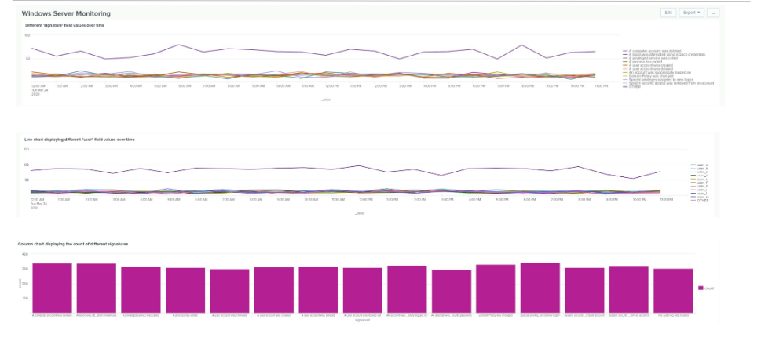
Dashboards—Windows

Slide 16
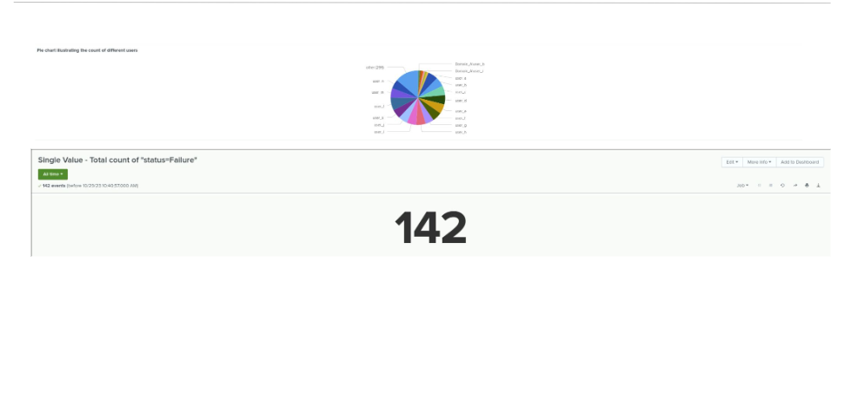
Dashboards—Windows

Slide 17
Apache Logs
‹#›

Slide 18
Reports—Apache
Designed the following reports:
Report Name | Report Description
HTTP methods | Table of different HTTP methods; insight into the type of HTTP activity being requested against VSI’s web server
Top 10 domain refers | Top 10 domains referring to VSI’s website; help to identify suspicious referrers
HTTP response code | Count of each HTTP response code; insight into any suspicious levels of HTTP responses

Slide 19
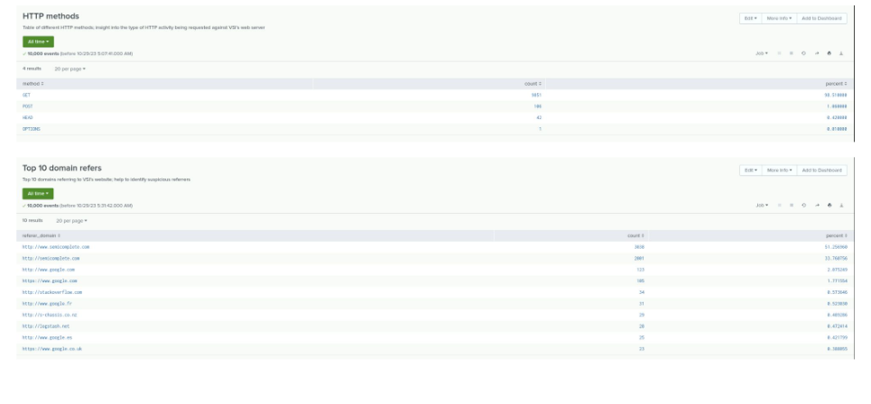
Images of Reports—Apache

Slide 20
Alerts—Apache
Designed the following alerts:
Alert Name | Alert Description | Alert Baseline | Alert Threshold
Hourly activity from Countries except United-states | Hourly Activity from Any Non United states Countries. An alert will triggered when the threshold has been reached. | 40 | 110
JUSTIFICATION: The average number of hourly activity coming from non-US Ip addresses was appox 40, therefore we set the baseline to be 40. The highest number of hourly activity recorded per hour was as high as 120, so we set the alert threshold to be 110, which would indicate suspicious activity.

Slide 21
Alerts—Apache
Designed the following alerts:
Alert Name | Alert Description | Alert Baseline | Alert Threshold
HTTP POST method | Hourly count of HTTP POST methods. An alert will triggered when the threshold has been reached. | 1.3 | 9
JUSTIFICATION: The average number of hourly count of HTTP POST methods is 1.28 per hour, therefore we set the baseline to be 1.3. The highest count of hourly activity recorded per hour was 7, so we set the alert threshold to be 9, which would indicate suspicious activity.

Slide 22
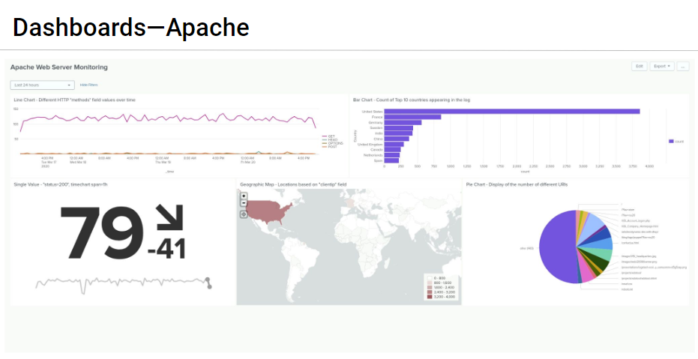

Slide 23
Attack Analysis
‹#›

Slide 24
Attack Summary—Windows
Summarize your findings from your reports when analyzing the attack logs.
Failed Windows Activity: The Windows Server experienced a significant number of failed activity attempts. The baseline was set at 6 failed activities per hour, and the alert threshold was 12. The attack aimed to gain unauthorized access or compromise the server's security.
Account Successful Logins: The server recorded an above-average number of successful account logins, with an average of 13.46 per hour. The baseline was 14, and the alert threshold was 28. The attackers might have gained unauthorized access or were attempting to maintain control over the server.
User Account Deletions: The Windows Server also observed a notable number of user account deletions, with an average of 13.25 per hour. The baseline was set at 14, and the alert threshold was 35. This could indicate an attempt to disrupt the system or obscure malicious activity.
These findings suggest that the attackers targeted the Windows Server to gain unauthorized access, potentially compromise security, and disrupt normal operations. Monitoring and investigating these alerts and logs were crucial in detecting and responding to the attack.

Slide 25
Attack Summary—Windows
Summary of findings from alerts when analyzing the attack logs:
-The average number of failed Windows activities was 5.708 per hour.
-The alert threshold was set at 12.
-The threshold appears to have been set effectively, as the number of failed activities never exceeded 10 within a 24-hour period. This suggests that the threshold was appropriately calibrated to detect suspicious activity without triggering excessive false positives.
Account Successful Logins Alert:
-The average number of successful logins was 13.46 per hour.
-The alert threshold was set at 28.
-The threshold seems to have been correctly configured, as the highest number of successful logins recorded per hour was 21. This indicates that the threshold effectively captured potentially suspicious login activity without being overly sensitive.
-Observed attack patterns.

Slide 26
Attack Summary—Windows
User Account Deletions Alert:
-The average number of user account deletions was 13.25 per hour.
-The alert threshold was set at 35.
-The threshold appeared to be adequately set, as the highest number of user account deletions recorded per hour was 30. This suggests that the threshold was calibrated to detect potentially disruptive or suspicious account deletion activity.
In summary, the established alert thresholds for failed Windows activity, successful logins, and user account deletions appear to have been set effectively. They helped in identifying potentially suspicious or disruptive activities without generating excessive false alarms. The thresholds seemed to be aligned with the characteristics of the monitored environment and the observed attack patterns.

Slide 27
Attack Summary—Apache
In our analysis of the attack logs, we have identified several key reports and alerts that provide insights into the activity against VSI's web server:
HTTP Methods Report Dashboard:
This report provides a table of different HTTP methods used in requests to VSI's web server.
It helps us understand the type of HTTP activity being requested against the server.
Offers a breakdown of different HTTP methods used in requests to VSI's web server.
Provides an understanding of the types of HTTP activity being requested against the server.
Useful for identifying potentially suspicious or unusual HTTP methods being used in requests.
Top 10 Domain Referrers Report:
This report lists the top 10 domains referring to VSI's website.
It assists in identifying potentially suspicious referrers that might be directing traffic to the server.
Helps in identifying potentially suspicious referrers that might be directing traffic to the server.
Offers insights into the sources of web traffic and their relevance.

Slide 28
HTTP Response Code Report:
This report counts each HTTP response code received by the server.
It offers insights into any unusual or suspicious levels of HTTP responses, which could indicate issues or attacks.
Moving on to the alerts:
Hourly Activity from 130.237.218.86 (Stockholm, Sweden):
This alert focuses on tracking hourly activity originating from the IP address 130.237.218.86 in Stockholm, Sweden.
The baseline for normal hourly activity is set at 15, with the highest recorded activity being 75 per hour.
An alert threshold of 85 has been established, which indicates potentially suspicious activity when surpassed.
HTTP POST Method Alert:
This alert monitors the hourly count of HTTP POST methods.
The baseline for normal activity is set at 1.3 per hour, with the highest recorded count being 7.
An alert threshold of 9 has been set, and it triggers when the count exceeds this threshold, indicating potentially
suspicious use of HTTP POST methods.
These reports and alerts help provide a detailed understanding of the HTTP activity and potential security threats against VSI's web server, enabling proactive measures to be taken in response to suspicious or unusual patterns of activity.

Slide 29
Summary and Future Mitigations
‹#›

Slide 30
Project 3 Summary (Windows)
What were your overall findings from the attack that took place?
The Windows Server experienced a suspicious level of failed activities, with an average of 5.708 per hour. The alert threshold was set at 12.
The server had successful account logins above the baseline, with an average of 13.46 per hour. Alert threshold was set at 28.
User account deletions occurred at an average rate of 13.25 per hour, with an alert threshold of 35
To protect VSI from future attacks, what future mitigations would you recommend?
Strengthen server security by implementing stronger access controls and password policies.
Implement intrusion detection systems to monitor and alert on unusual or suspicious activities.
Regularly review and update security configurations, including firewall rules and server hardening.
Conduct security awareness training for employees to prevent social engineering attacks.
Implement regular security audits and penetration testing to identify vulnerabilities.
Consider encrypting sensitive data on the Windows Server to protect intellectual property.
Implement a web application firewall (WAF) for the Apache Server to protect against web-based attacks on the public-facing website.
Keep software and server components updated with security patches and updates.
Develop an incident response plan to address and mitigate future security incidents effectively.

Slide 31
Project 3 Summary (Apache Server)
Our overall findings from the attack that took place were:
-The analysis of HTTP methods, top domain referrers, and HTTP response codes provided insights into the types of requests and traffic sources.
-The alerts related to hourly activity and HTTP POST methods revealed patterns of potentially suspicious activity.
To protect VSI from future attacks, what future mitigations would you recommend:
-Continuous Monitoring and Analysis.
-Threshold Fine-Tuning.
-Anomaly Detection.
-Geographic Blocking.
-Web Application Firewall (WAF).
-Incident Response Plan.
-Regular Security Audits.
-User Training and Awareness.

